Slide 1
Link Stealing Attacks on Inductive
Trained Graph Neural Networks
Bachelor Thesis Introduction - Philipp Zimmermann

Slide 2
Outline
Graphs
Graph Neural Networks
Our Approach: Link Stealing Attacks on Inductive Trained Graph Neural Networks
Experimental Setup
Goal

Slide 3
Graphs

Slide 4
Graphs
Data Structure
  Model large data and relationships between entities
  Nodes with features
  Edges

Slide 5
Graphs
Data Structure
  Model large data and relationships between entities
  Nodes with features
  Edges
Chemical Networks
  Protein-protein interactions

Slide 6
Graphs
Data Structure
  Model large data and relationships between entities
  Nodes with features
  Edges
Chemical Networks
  Protein-protein interactions
Social Networks
  Instagram
  Facebook
  Twitter

Slide 7

Graphs
Data Structure
  Model large data and relationships between entities
  Nodes with features
  Edges
Chemical Networks
  Protein-protein interactions
Social Networks
  Instagram
  Facebook
  Twitter

Slide 8

Graphs
Data Structure
  Model large data and relationships between entities
  Nodes with features
  Edges
Chemical Networks
  Protein-protein interactions
Social Networks
  Instagram
  Facebook
  Twitter

Slide 9
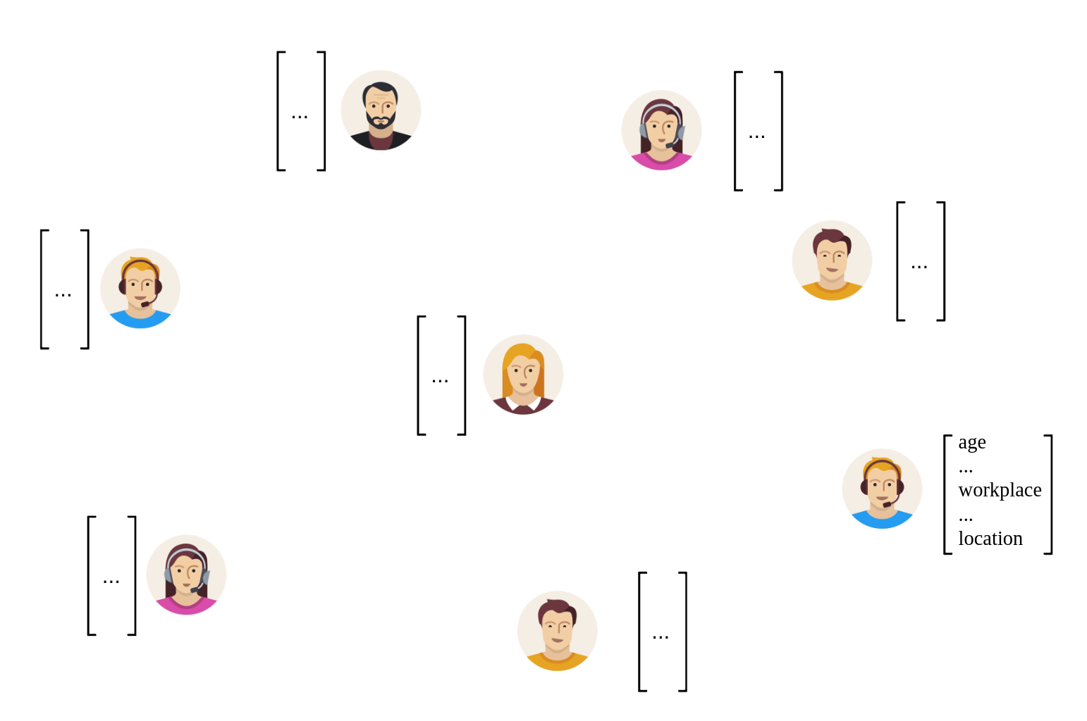
Graphs
Data Structure
  Model large data and relationships between entities
  Nodes with features
  Edges
Chemical Networks
  Protein-protein interactions
Social Networks
  Instagram
  Facebook
  Twitter

Slide 10
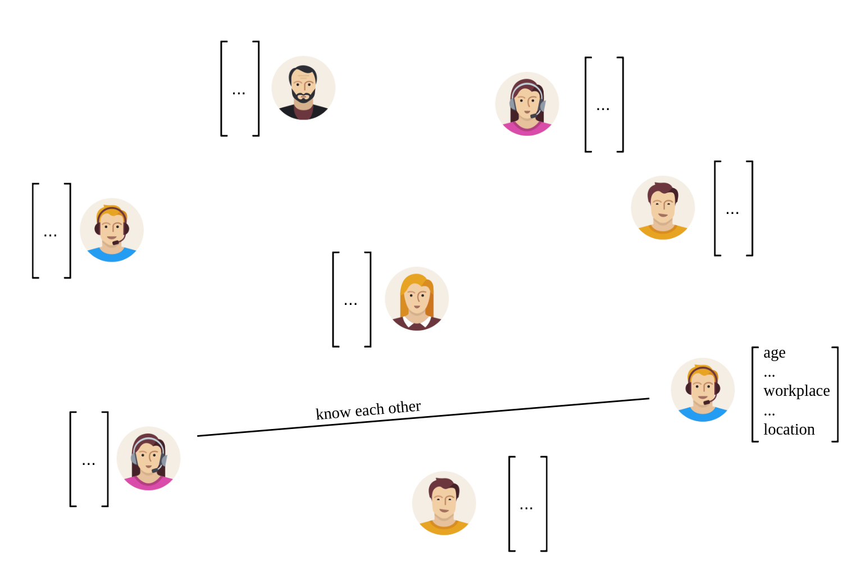
Graphs
Data Structure
  Model large data and relationships between entities
  Nodes with features
  Edges
Chemical Networks
  Protein-protein interactions
Social Networks
  Instagram
  Facebook
  Twitter

Slide 11
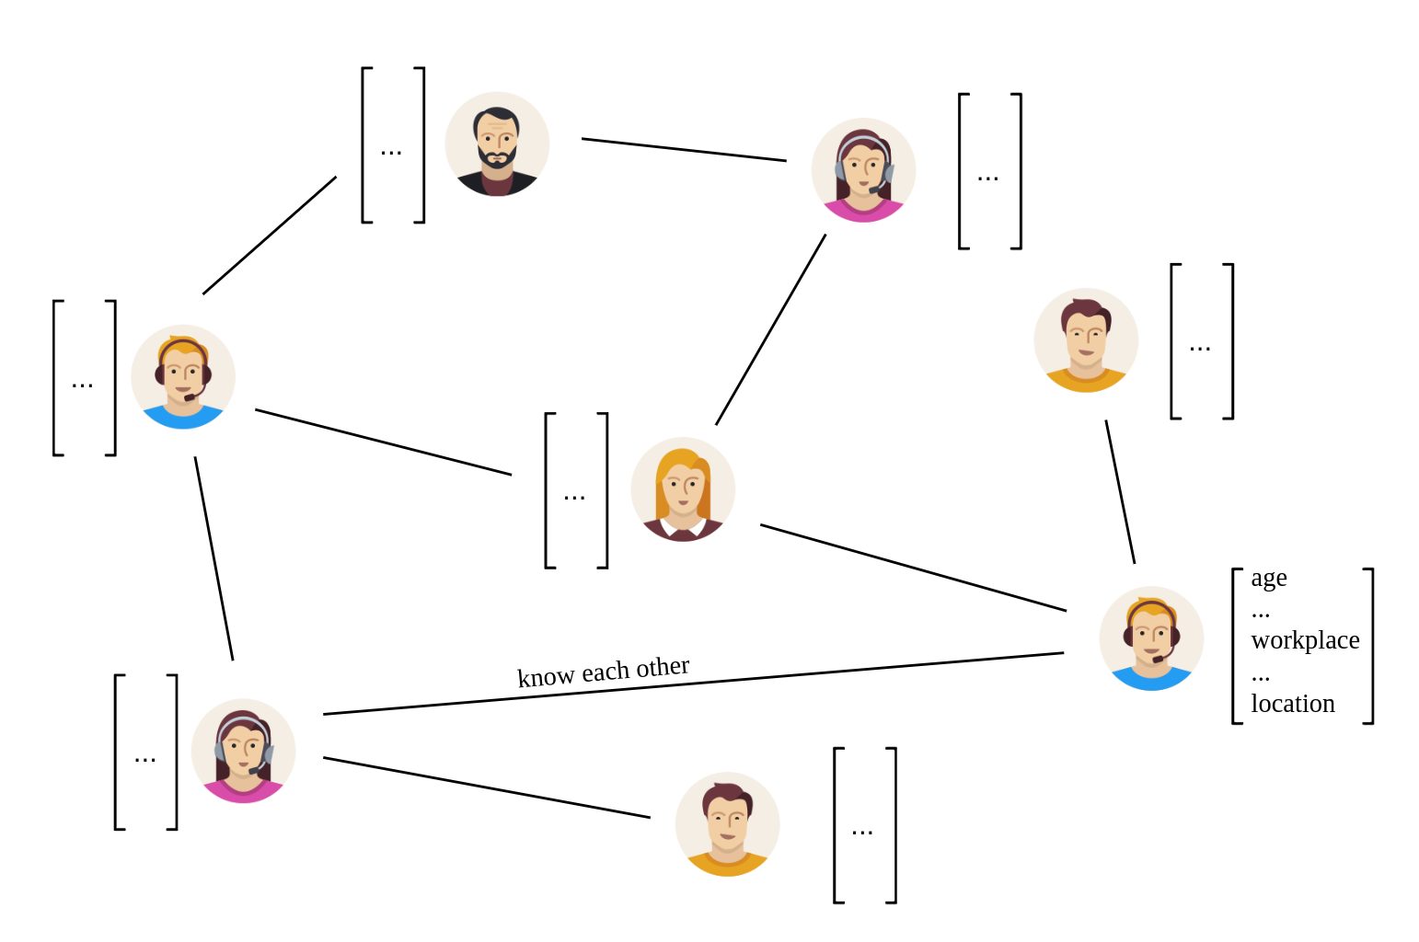
Graphs
Data Structure
  Model large data and relationships between entities
  Nodes with features
  Edges
Chemical Networks
  Protein-protein interactions
Social Networks
  Instagram
  Facebook
  Twitter

Slide 12
Graph Neural Networks (GNNs)

Slide 13
Graph Neural Networks
Machine Learning Model over Graphs
Different Tasks
  Node classification
  Graph classification
  Link prediction
Different Learning Methods
  Transductive
  Inductive

Slide 14
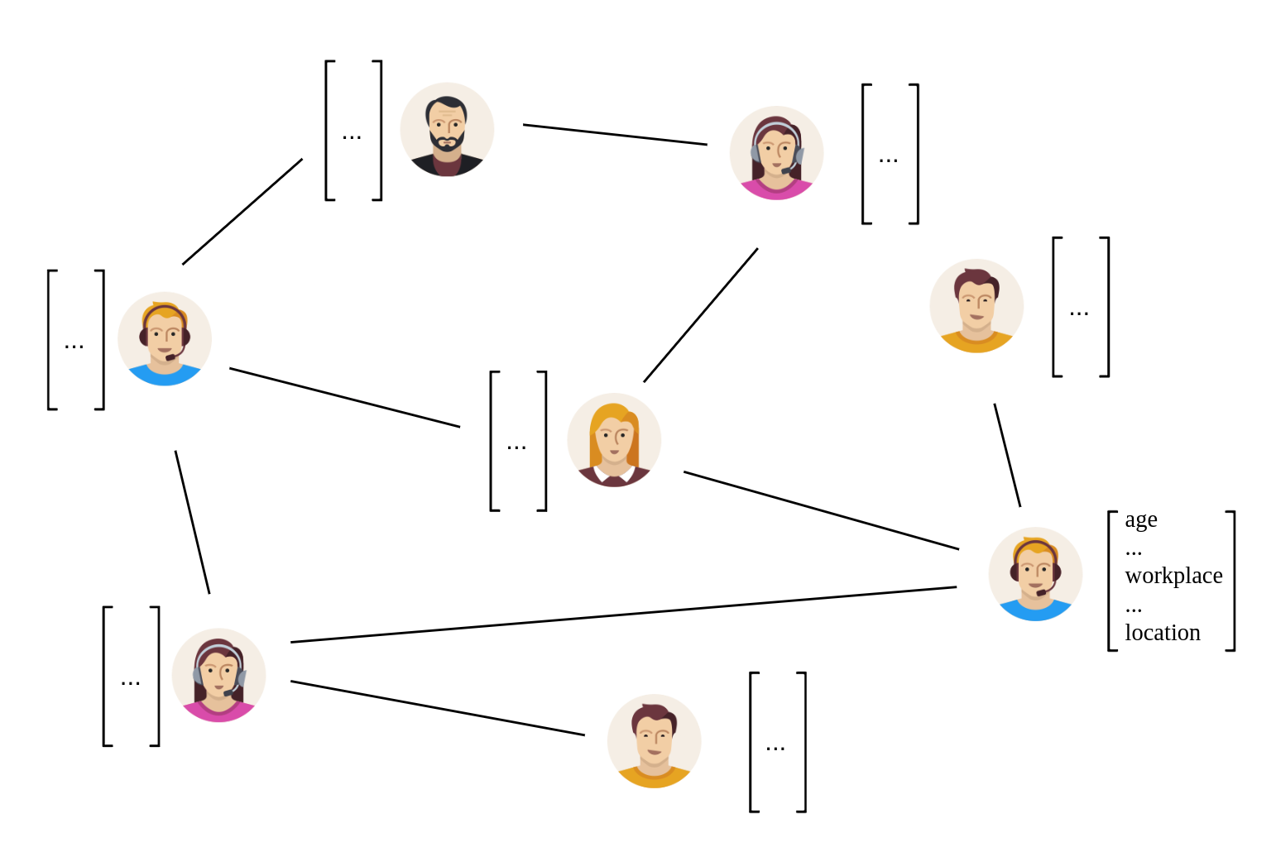
Graph Neural Networks
Transductive

Slide 15

Graph Neural Networks
Transductive

Slide 16
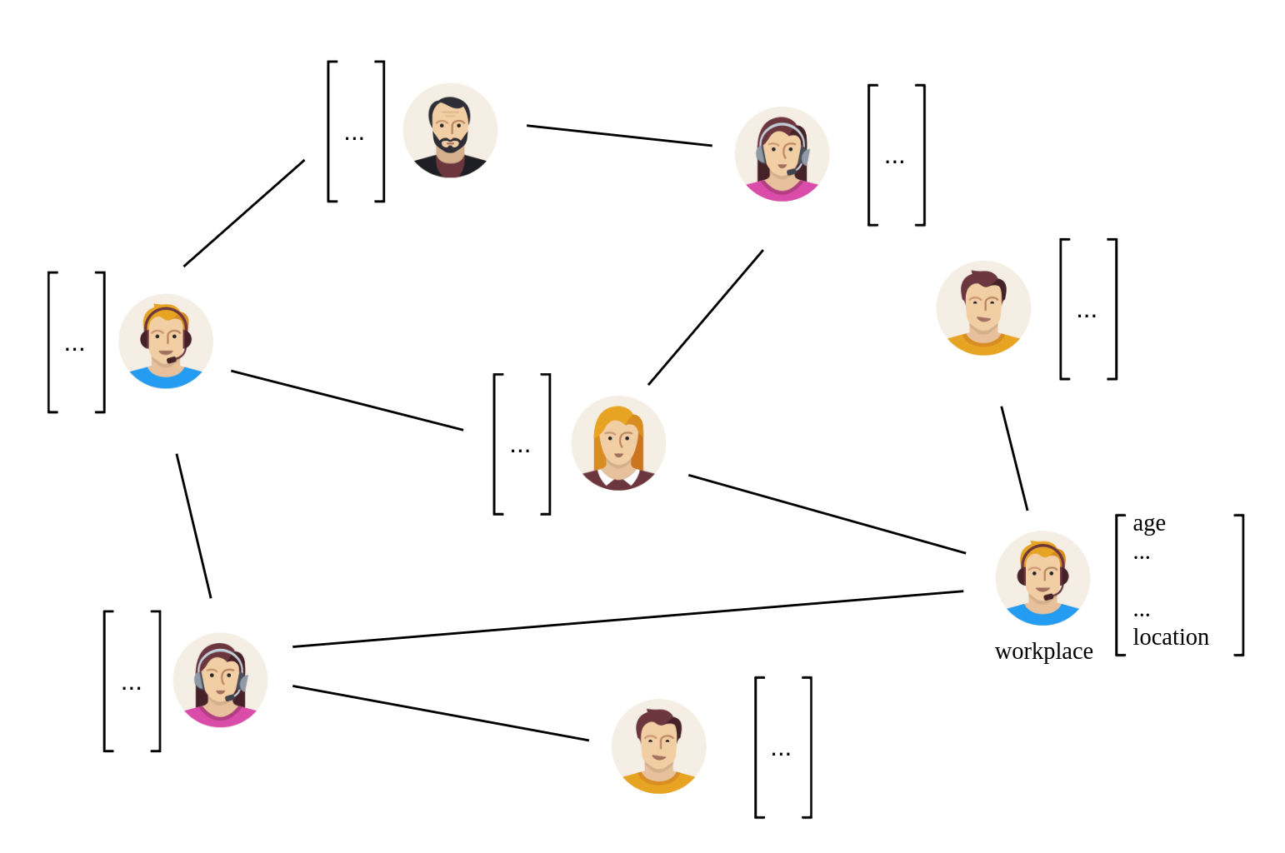
Graph Neural Networks
Transductive

Slide 17
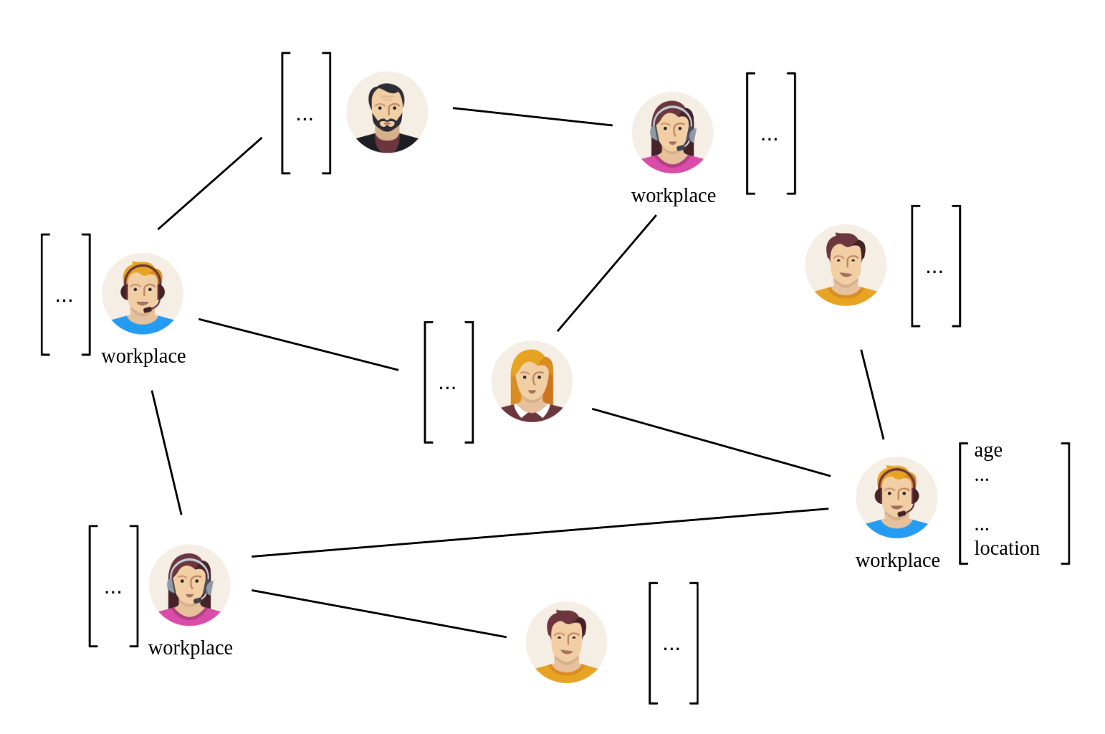
Graph Neural Networks
Transductive

Slide 18
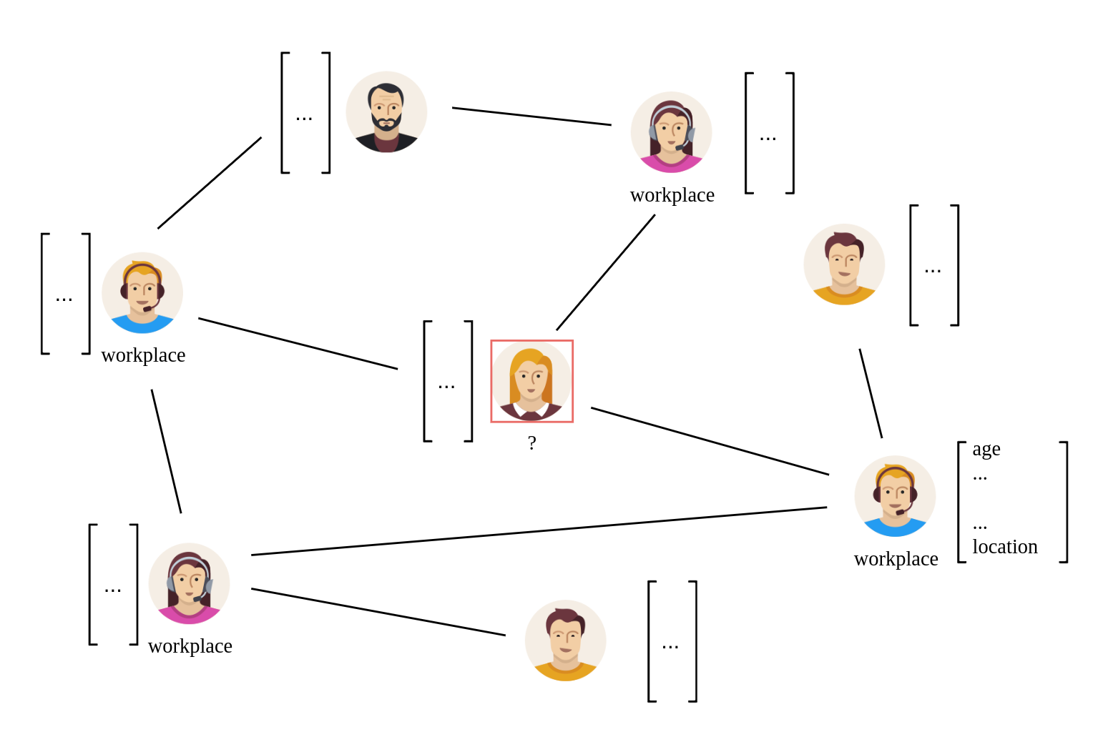
Graph Neural Networks
Transductive

Slide 19
Graph Neural Networks
Transductive
  Fix graph (features and link)
  Some nodes’ labels are missing
  Limited scenario

Slide 20
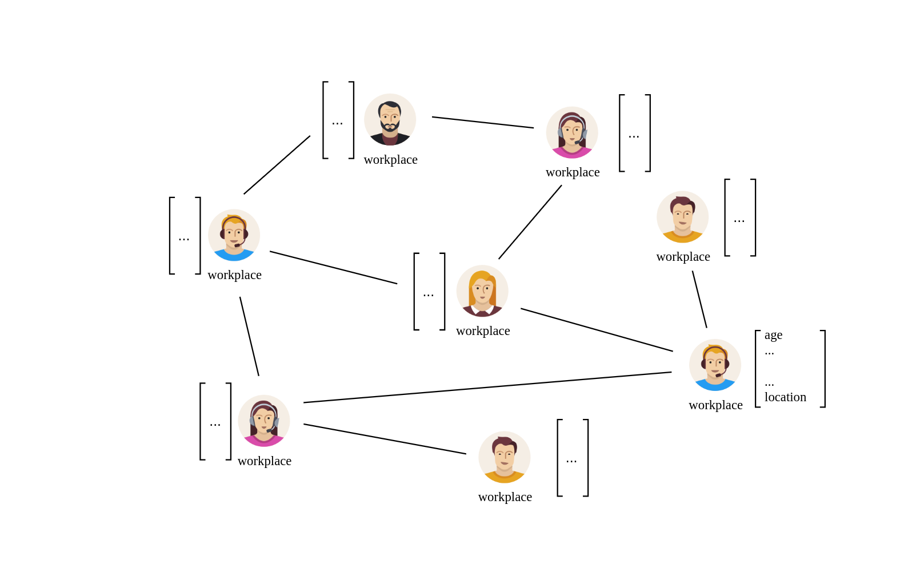
Graph Neural Networks
Inductive

Slide 21
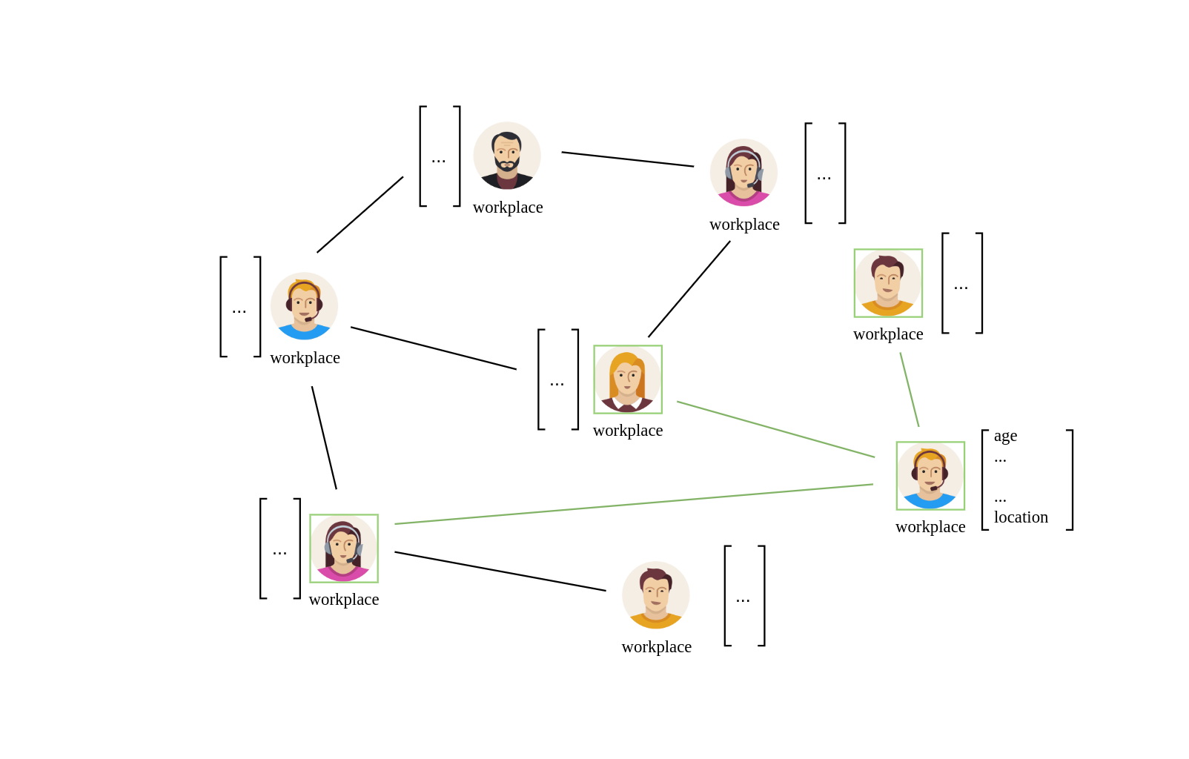
Graph Neural Networks
Inductive

Slide 22
Graph Neural Networks
Inductive

Slide 23
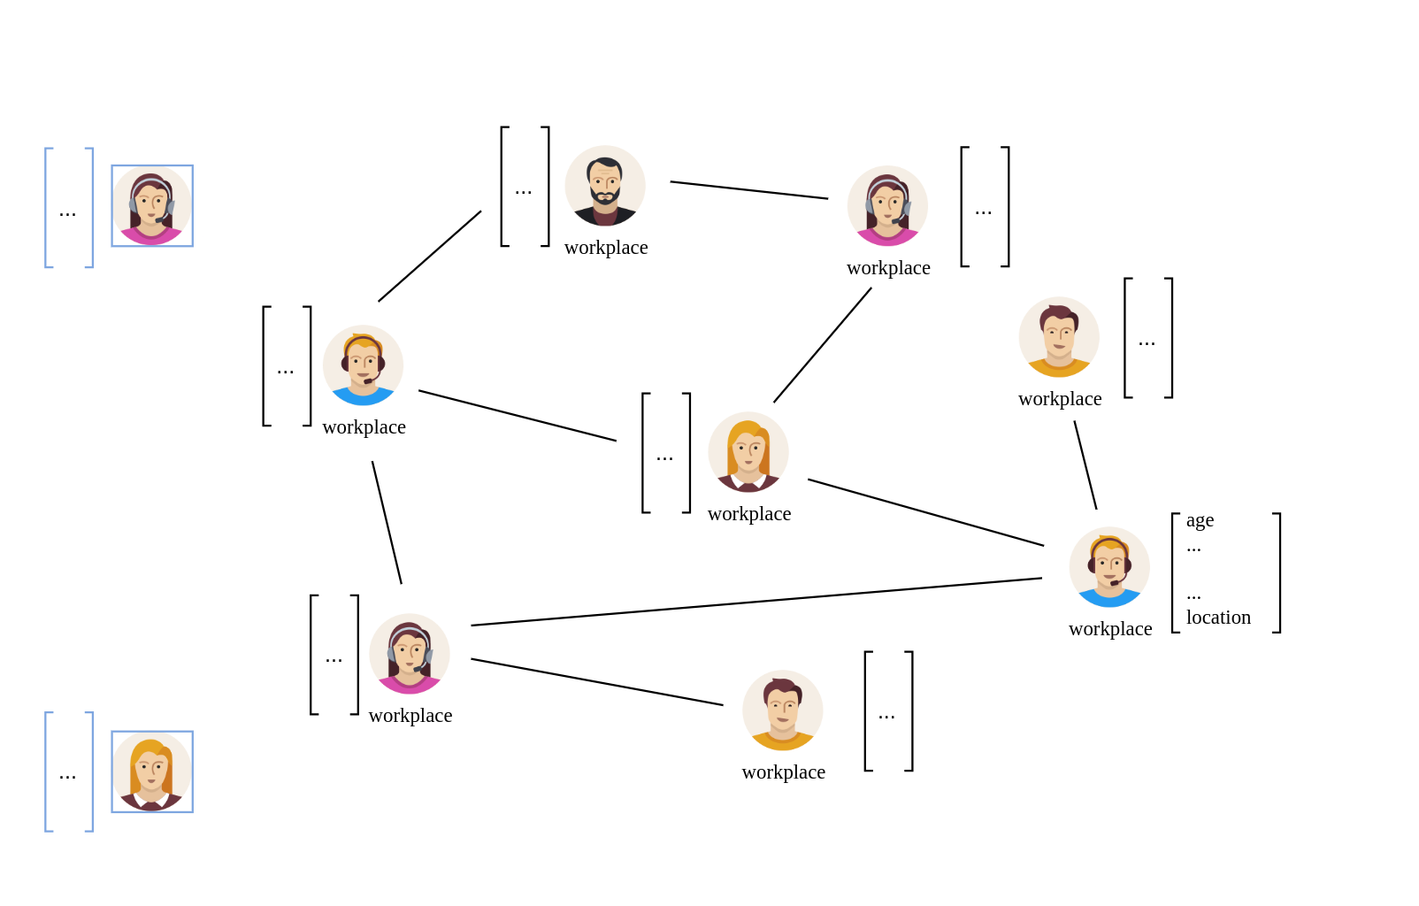
Graph Neural Networks
Inductive

Slide 24
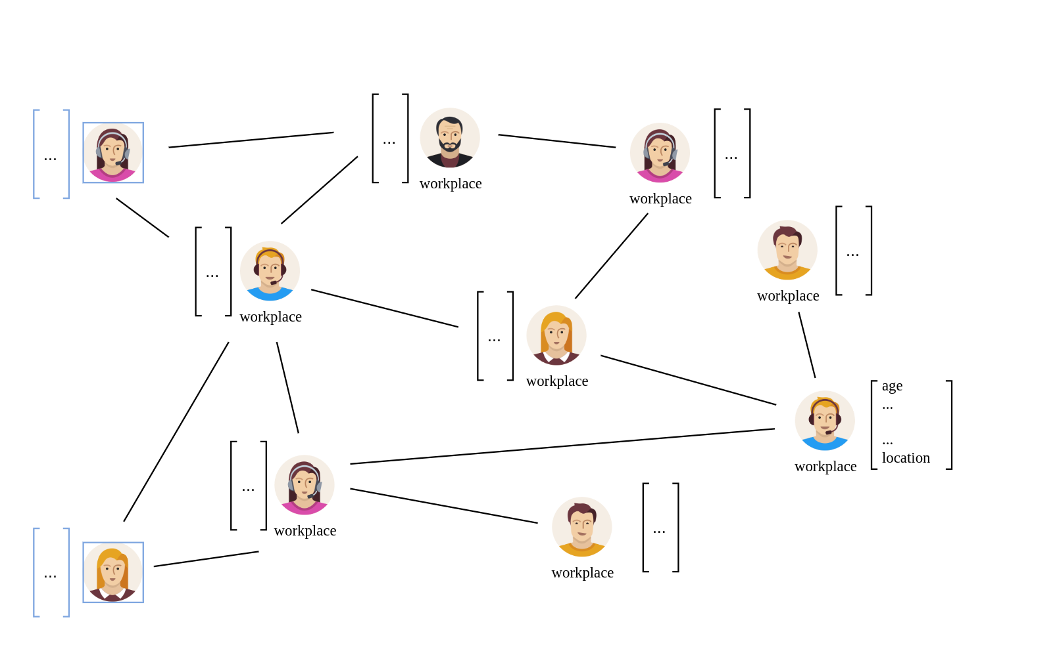
Graph Neural Networks
Inductive

Slide 25
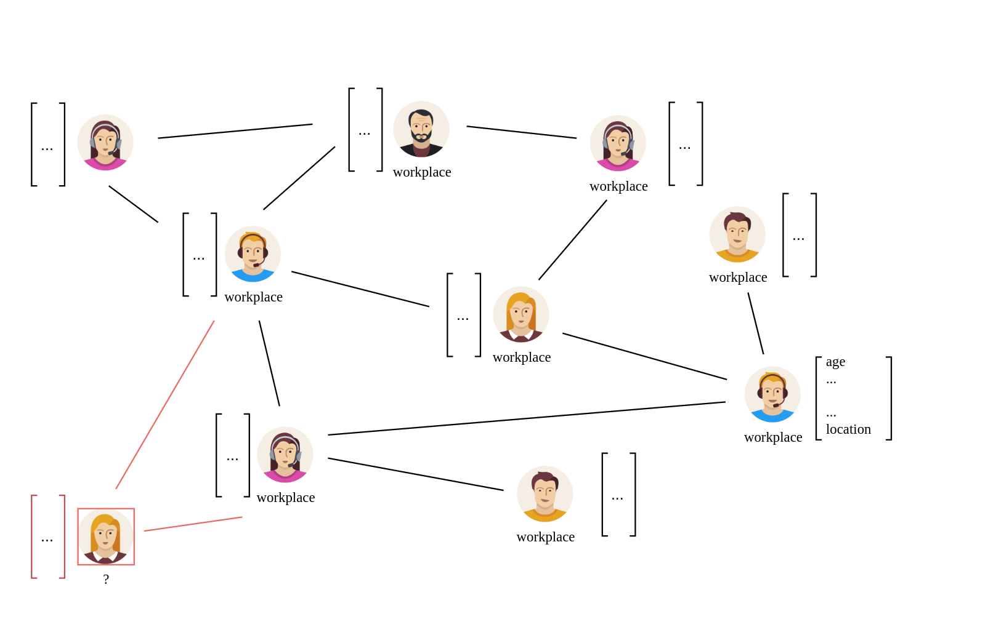
Graph Neural Networks
Inductive

Slide 26
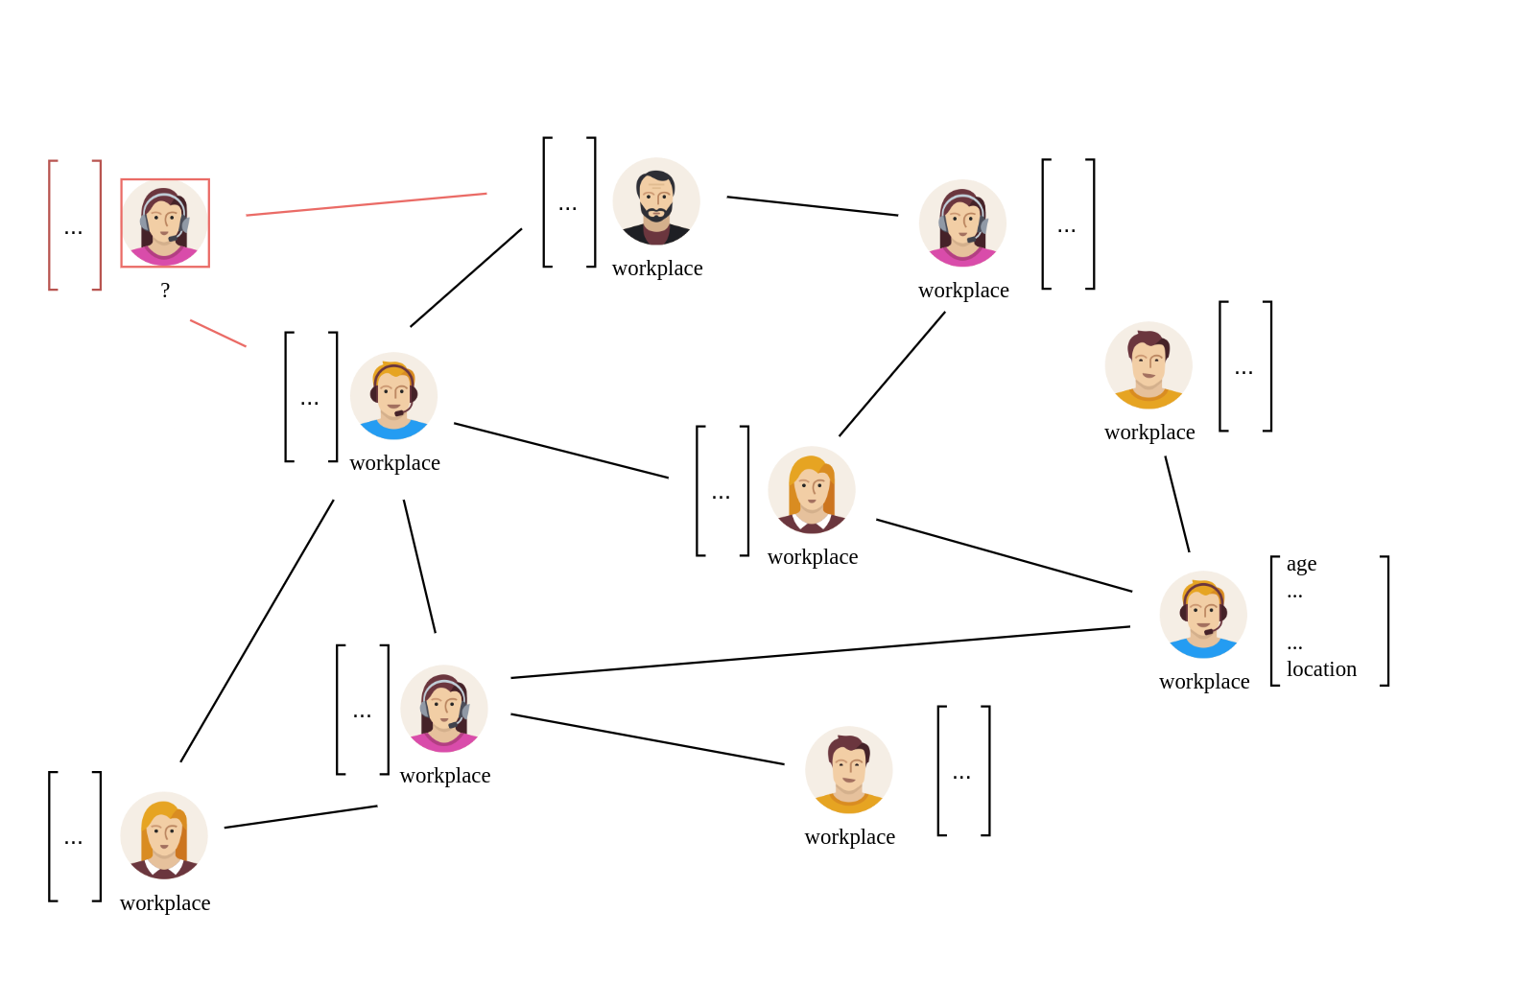
Graph Neural Networks
Inductive

Slide 27
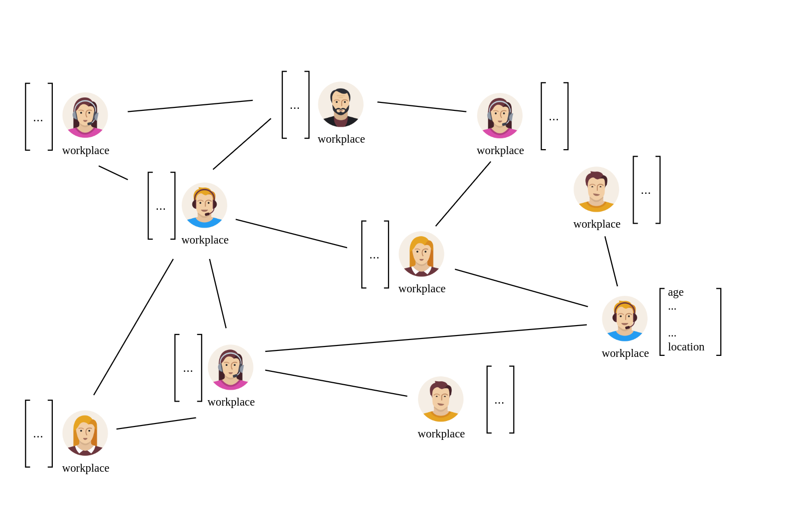
Graph Neural Networks
Inductive

Slide 28
Graph Neural Networks
Inductive
  Extends transductive setting
  Able to generalize to unseen nodes
  Unnecessary to retrain the model
  Broader scenario

Slide 29
Our Approach:
Link Stealing Attacks

Slide 30
Link Stealing Attacks
First Introduced by Dr. Yang Zhang and Xinlei He in 2020
  Attacks on transductive trained GNNs
Scenario:
  GNN trained on graph G to perform downstream task
  Attacker
    Black box access to target model
    Partial graph with incomplete set of edges
Goal:
  Recover missing links from partial graph

Slide 31
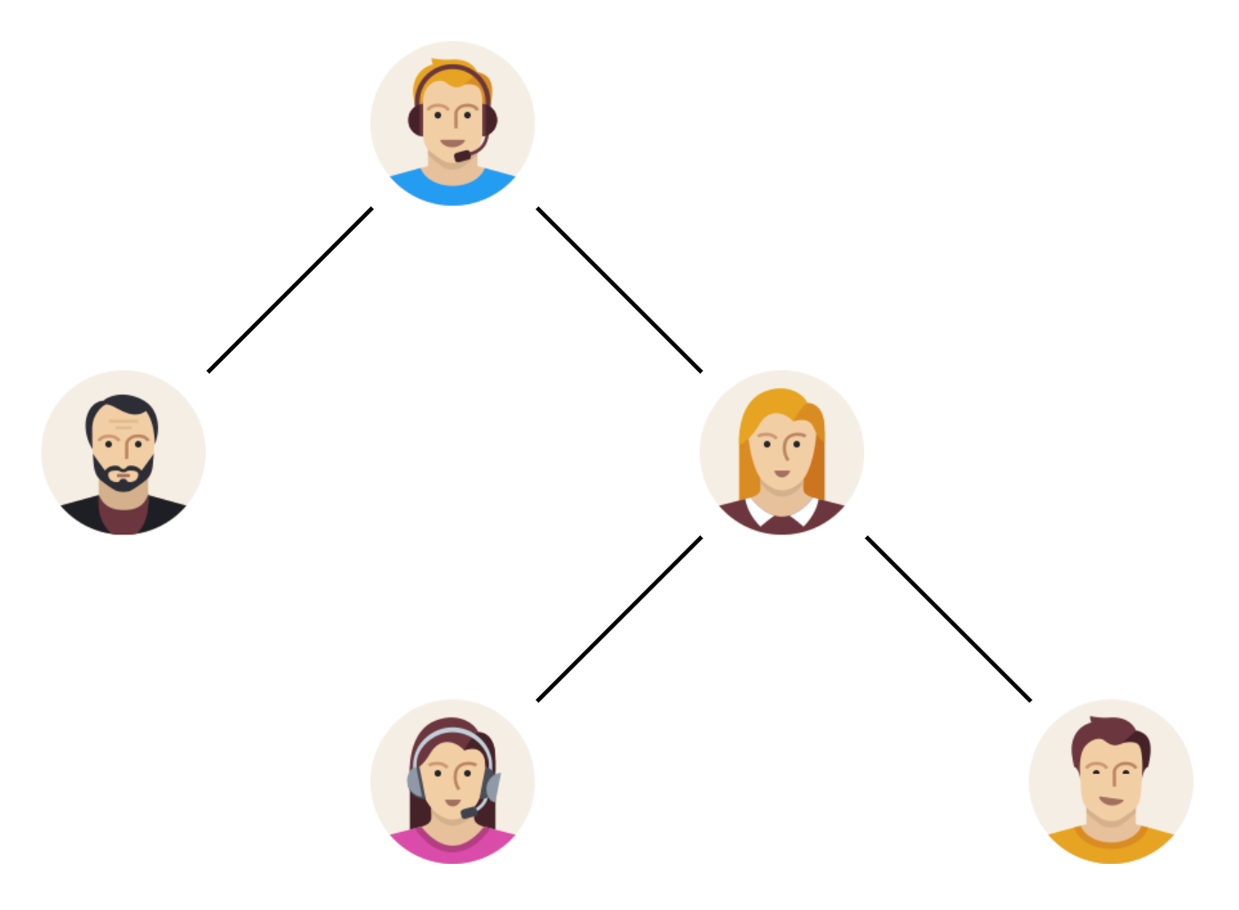
Link Stealing Attacks
Graph Neural Network
( Target Model )
train

Slide 32
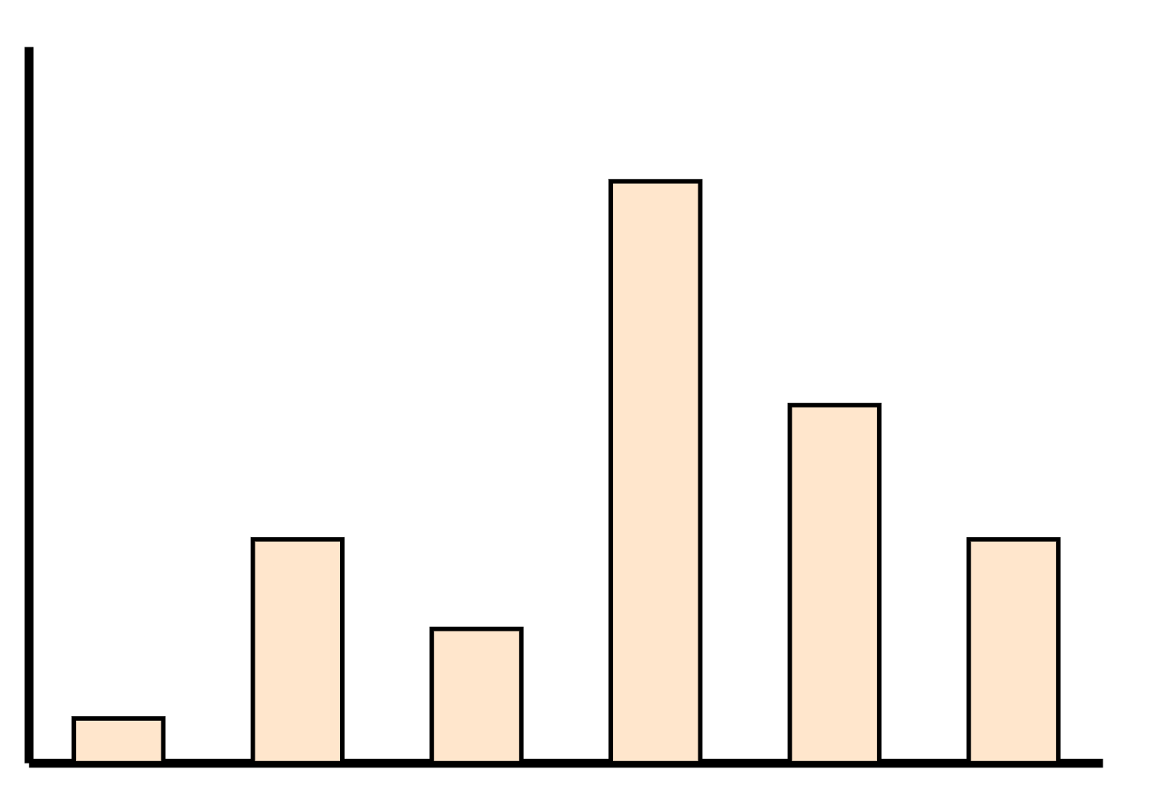
Link Stealing Attacks
Graph Neural Network
( Target Model )
query
output

Slide 33
Link Stealing Attacks
Attacker Graph

Slide 34
Link Stealing Attacks
Attacker Graph with One Missing Link

Slide 35
Link Stealing Attacks
Attacker Graph

Slide 36
Link Stealing Attacks

Slide 37
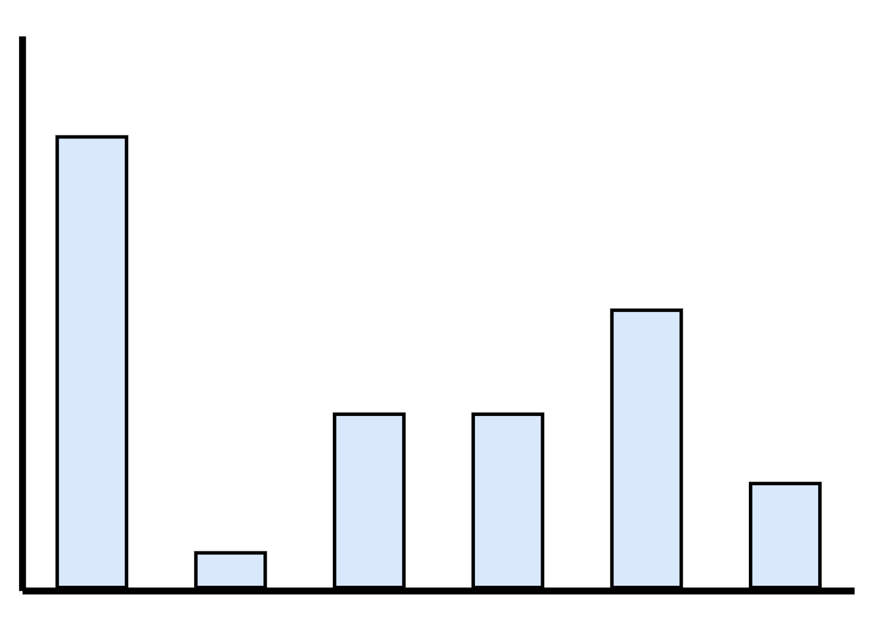
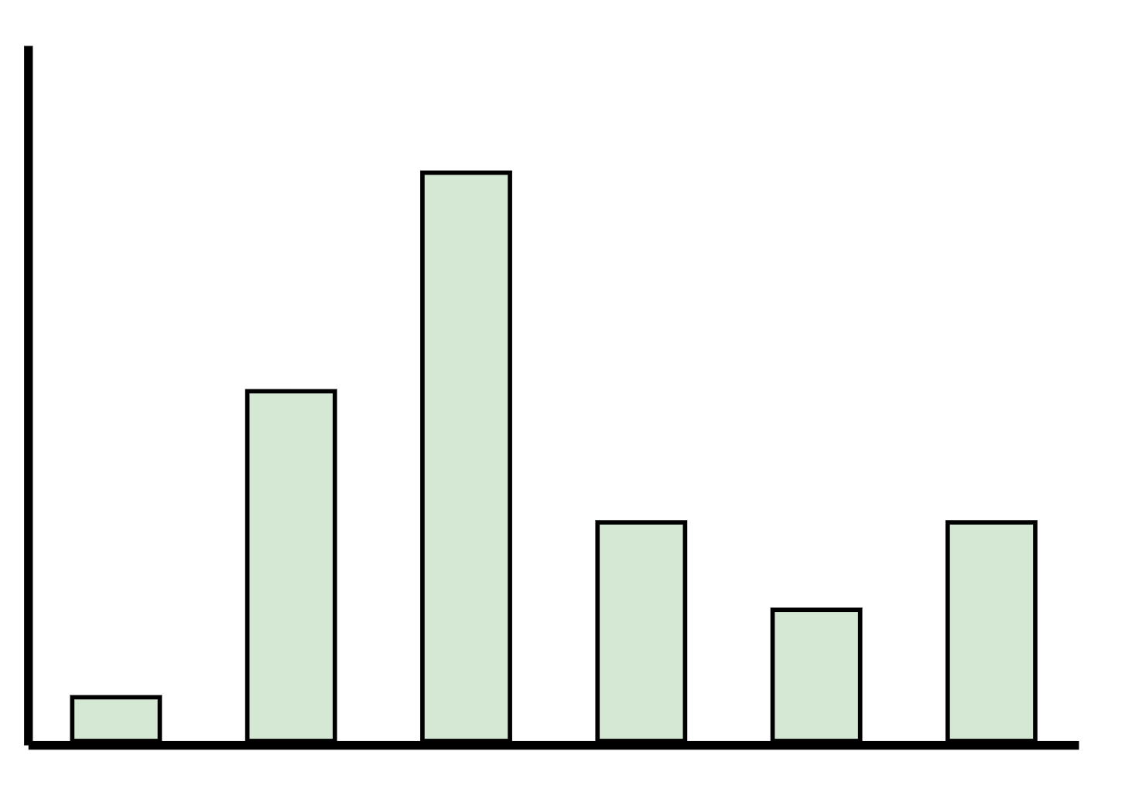
Link Stealing Attacks
GNN
( Target Model )
GNN
( Target Model )

Slide 38
Link Stealing Attacks

Slide 39
Link Stealing Attacks
[ 0.3, 0.2, 0.3, …, 0.1 ]
[ 0.2, 0.1, 0.4, …, 0.1 ]

Slide 40
Link Stealing Attacks
[ 0.3, 0.2, 0.3, …, 0.1 ]
[ 0.2, 0.1, 0.4, …, 0.1 ]

Slide 41
Link Stealing Attacks
[ 0.3, 0.2, 0.3, …, 0.1 ]
[ 0.2, 0.1, 0.4, …, 0.1 ]

Slide 42
Link Stealing Attacks
[ 0.3, 0.2, 0.3, …, 0.1 ]
[ Cosine, Manhattan, …, Euclidean ]
[ 0.2, 0.1, 0.4, …, 0.1 ]

Slide 43
Link Stealing Attacks
[ Cosine, Manhattan, …, Euclidean ]

Slide 44
Link Stealing Attacks
[ Cosine, Manhattan, …, Euclidean ]
MLP
( Attack Model )

Slide 45
Link Stealing Attacks
[ Cosine, Manhattan, …, Euclidean ]
MLP
( Attack Model )
Prediction whether two nodes are connected or not

Slide 46
Experimental Setup

Slide 47
Experimental Setup
Three Datasets
  Cora
  CiteSeer
  Pubmed
Three Graph Neural Network Types
  GraphSAGE
  GAT
  GCN (inductive)

Slide 48
Experimental Setup
Attack 1
  Same distribution
[ 0.3, 0.2, 0.3, …, 0.1 ]
[ 0.2, 0.1, 0.4, …, 0.1 ]
[ 0.3, 0.2, 0.3, …, 0.1, 0.2, 0.1, 0.4, …, 0.1 ]
MLP
( Attack Model )

Slide 49
Experimental Setup
Attack 2
  Same Distribution
[ Cosine, Manhattan, …, Euclidean ]
MLP
( Attack Model )

Slide 50
Experimental Setup
Attack 3
  Different Distribution
[ Cosine, Manhattan, …, Euclidean ]
MLP
( Attack Model )

Slide 51
Goal

Slide 52
Goal
Observation
  Inductive trained GNNs are likely to reveal sensitive information about their training graph?

Slide 53
Results

Slide 54
Intuition
Inductive Setting
  Different Results for Different Amount of Known Edges
More Background Knowledge
  Better Attack Performance

Slide 55
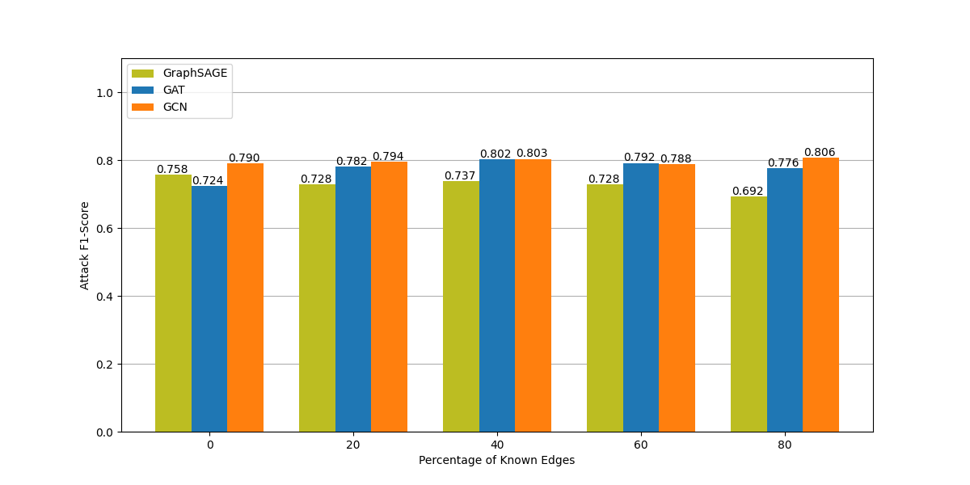
Attack 1 - CiteSeer

Slide 56
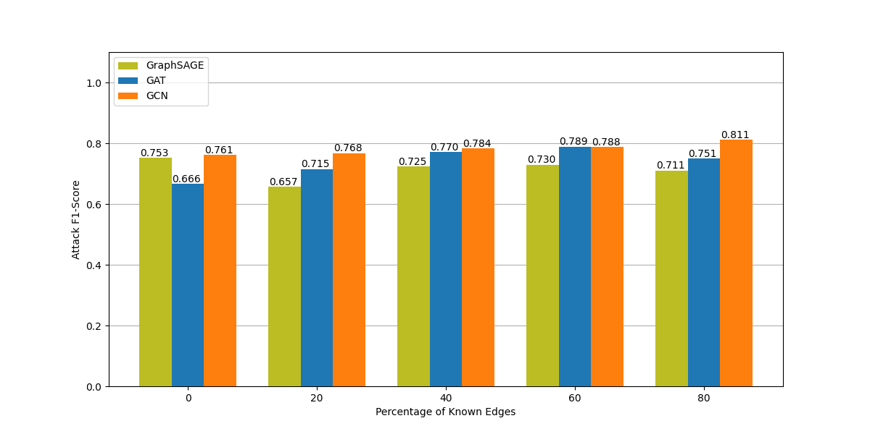
Attack 1 - Cora

Slide 57
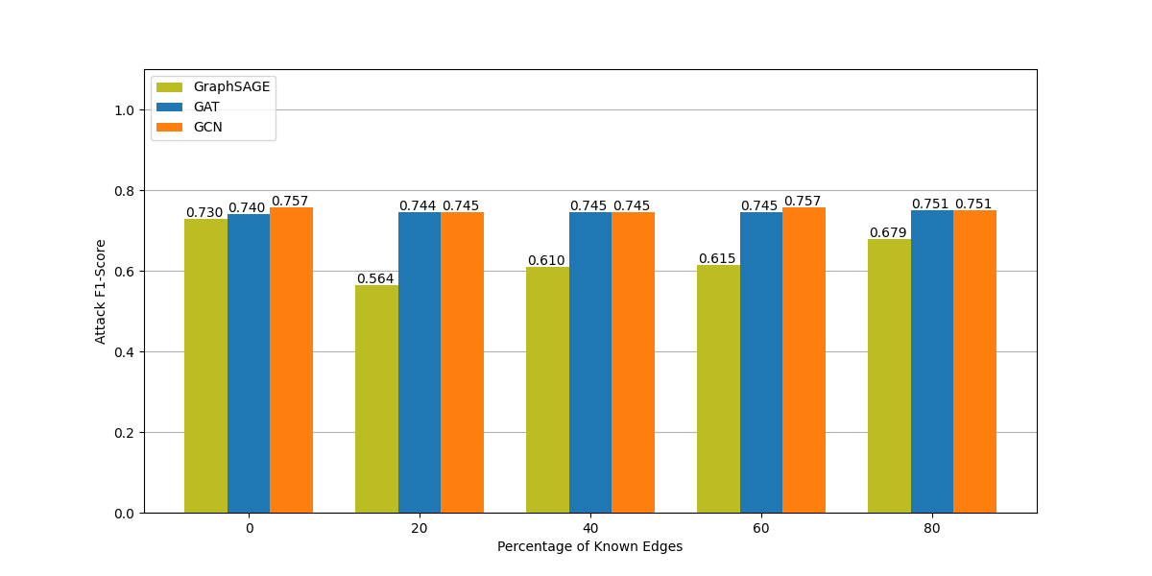
Attack 1 - Pubmed

Slide 58
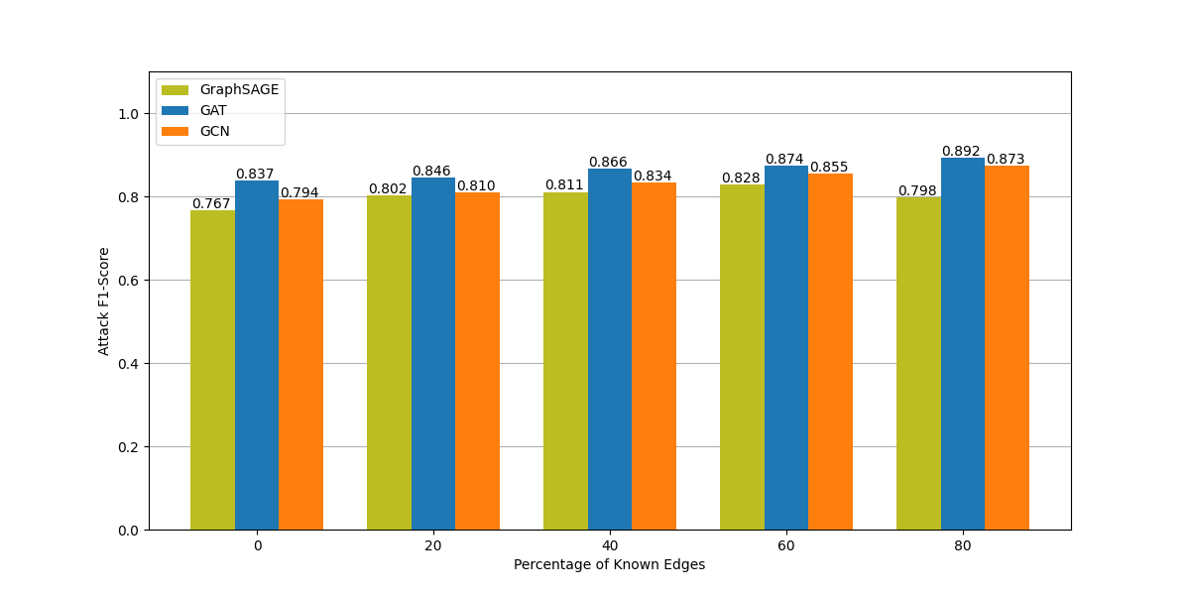
Attack 2 - CiteSeer

Slide 59
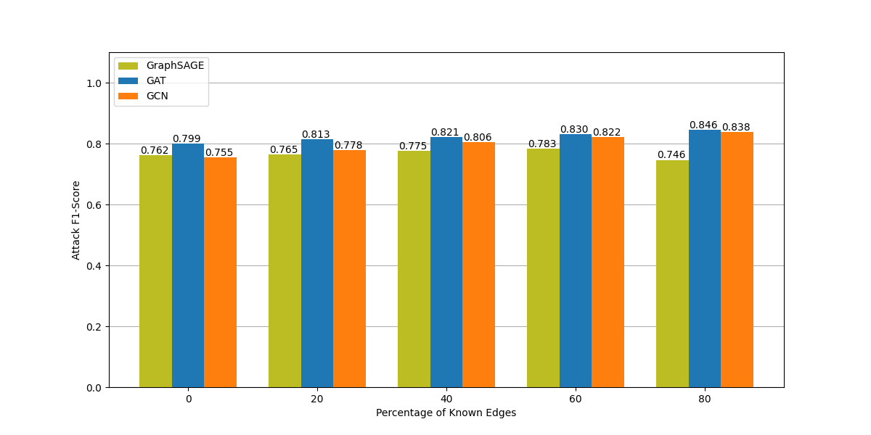
Attack 2 - Cora

Slide 60
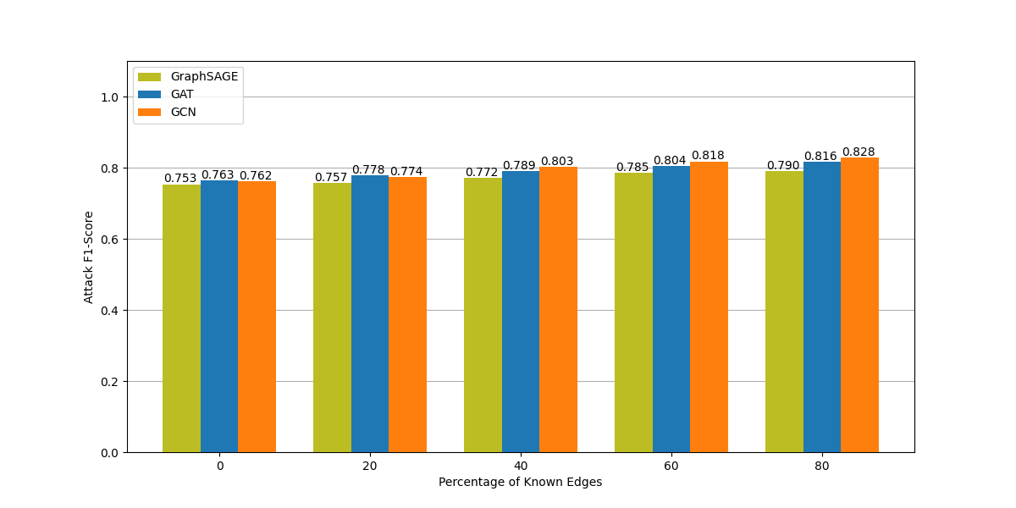
Attack 2 - Pubmed

Slide 61
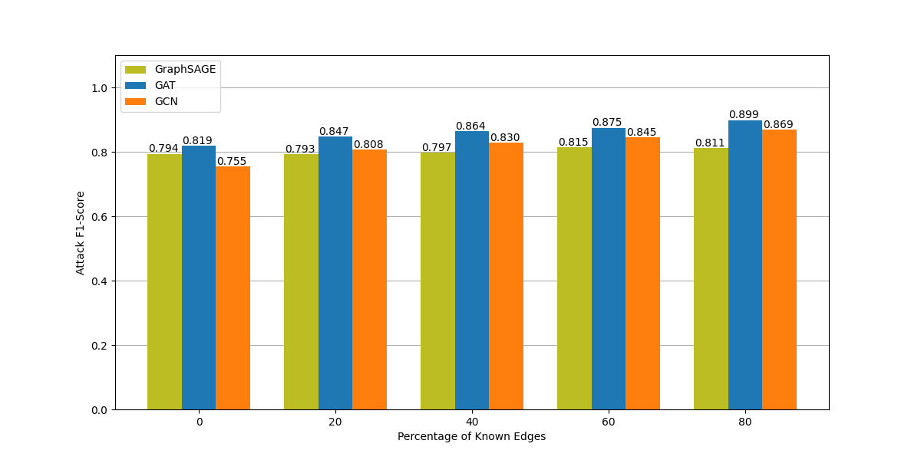
Attack 3 – CiteSeer – Cora

Slide 62

Attack 3 – CiteSeer – Pubmed

Slide 63
Findings

Slide 64
Findings
Efficiently Steal Links from Inductive Trained Graph Neural Networks
  Black Box Access
  Multiple Strategies
    Concatenation of Posteriors
    Distance Vector
  More Background Knowledge → Better Attack Performance
  Different Dataset Distributions → Similar Results like Same Distribution

Slide 65
Findings
Serious Concerns
  Intellectual property
  Confidentiality
  Privacy

Slide 66
Future Work

Slide 67
Future Work
Different Downstream Tasks
Order of Posteriors
Different Feature Samples
Defense

Slide 68
Questions?

